Slide 1
Kennel Kounter
A database for animal management
Brought to life by: Brian McGarry, Ferris DeHart, Raquel Hodgeson, and Clyde Ball

Slide 2
Our pets are our best friends.
They give us company and love. They’re the first to greet us at the door, and the last to see us off.
But not all animals are as lucky as the ones sleeping on our couches right now. Some are living their lives in kennels and shelters, easily lost in a system that processes hundreds of animals at a time.

Slide 3
An easy to use and informative system designed to seamlessly track the flow and attributes of animals as they journey from kennel to home.
Our Solution? Kennel Kounter.

Slide 4
Our Data
Entered by hand
6 .csv files
Statistics
Animals - 100
Behaviors - 100
Medical - 100
Playgroups - 20
Fosters - 33
Kennels - 62
61 Dogs
43 Cats
20 dogs in playgroups
33 Animals in foster homes
62 Animals in kennels
Based on research and experience with animal shelters
“A living database, for living beings”
Notes:
raquel

Slide 5
Animals
Fosters
Medical
Kennels
Playgroup
Animal ID, name, weight, species, breed, age, location, sex
Animal ID, foster’s name, phone number, and ID
Animal ID, weight, vaccination, chip, flea treatment status, fixed status
Animal ID, Kennel ID
Animal ID, Playgroup ID
Behaviors
Animal ID, Playgroup status, friendliness towards cats/dogs/people, potty trained, any special traits
Notes:
Ferris

Slide 6

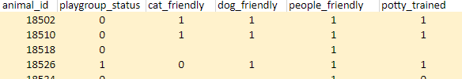
Animal ID: the pin that holds our system together
animal_id - unique ID for each animal
Primary key for all tables
Foreign key for 5 other tables
5 out of our 6 tables are in BCNF; in these, animal_id is the only value needed to identify a record, and all other attributes are fully dependent on it
Table “Behaviors” is in 1NF, since the value of dog_friendly functionally determines playgroup_status
Notes:
clyde

Slide 7
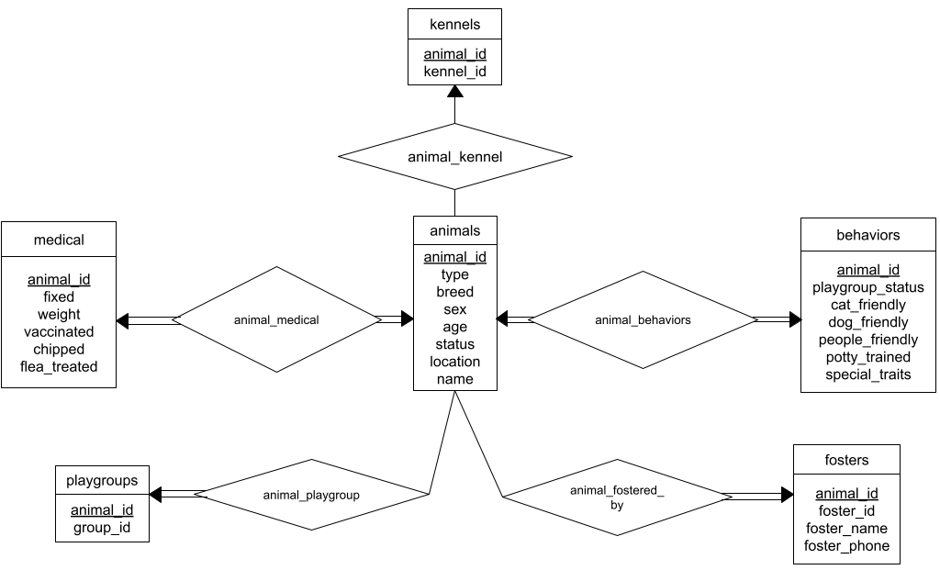
Entity-Relation Diagram
Notes:
brian

Slide 8
Querying
Return the animal_id, name, breed, sex, and weight of dogs that have some Terrier in them and weigh less than 55 pounds sort by ascending weight
SELECT animal_id, name, breed, sex, weight
FROM animals NATURAL INNER JOIN medical
WHERE type = 'Dog' AND breed like '%Terrier%'
GROUP BY weight
HAVING weight < 55
ORDER BY weight ASC;
18958|Ziggy |Jack Russell Terrier |M|17.4
19070|Levi |Rat Terrier |F|21.7
18550| |Jack Russell Terrier |F|33
18534| |Jack Russell Terrier |M|35
18702|Rocky Road|Rat Terrier |M|45
18630|Louie |American Staffordshire Terrier|M|53
Notes:
raquel

Slide 9
What we learned
Benefits of Normal Form
Importance of Assumptions
Process of creating and querying a database
Notes:
raquel

